Slide 1
Office 365 Development
July 2014

Slide 2
Course Agenda
Introduction to Office 365 Development
Module 1: Deep Dive Apps for Office in Outlook
Module 2: Deep Dive Apps for Office in Word
Module 3: Deep Dive Apps for Office in PowerPoint
Module 4: Deep Dive Apps for Office in Excel
Module 5: Deep Dive into SharePoint Hosted Apps
Module 6: Deep Dive into Provider Hosted Apps
Module 7: Deep Dive into Security and OAuth
Module 8: App Lifecycle Management

Slide 3
Deep Dive Apps for Office in Outlook
Speaker
Speaker

Slide 4

Agenda
Intro to Mail Apps
Contextual Activation and Rules
Using JSOM for Outlook
Compose Apps
Security Considerations

Slide 5
What is an App for Office?
A Web page loaded inside an Office Application
Embedded inline or as task pane within documents, mails or appointments.
Works in both Office Applications and Office Web Applications
Office application extensions using Web technologies
HTML 5 and CSS used to construct user interface
JavaScript and jQuery used to add executable logic and event handlers
App can provided code to read/write content to/from Office documents
App can call Web services hosted over Internet or running within local network
Notes:
An App for Office can be seen as a Web page loaded inside an Office Application. In some cases it will appear embedded inline within the document. In other cases it might appear as a task pane or within a message in Outlook. Note that the architecture for Apps for Office has been designed to work in both Office Applications and Office Web Applications.
WEF and Apps for Office allow Office applications to be extended in such as way so that they can leverage Web technologies such as HTML 5 and CSS for rendering user interface as well as JavaScript and jQuery to add behavior. When you write the JavaScript code for an App for Office, you can call REST APIs such as those added to SharePoint 2013 to retrieve and update data from across network.

Slide 6
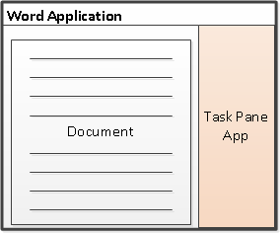
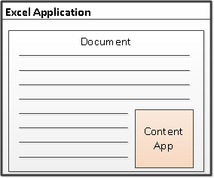
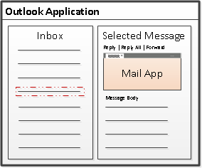
Designing Apps for Office - Shapes
Apps for Office come in three different shapes
Task Pane App
Content App
Mail App (only shape supported by Outlook and OWA)
Notes:
When you begin to design an app, you must pick one of the three different shapes. You can create a document-based app as either a Task Pane App or a Content App. Alternatively, you can create a Mail App that targets Outlook and Outlook OWA.

Slide 7
App for Office Runtime Environment
Web Extensibility Framework (WEF)
Allows Web page content to render inside Office Application
Allows Web page code to run within a set of constraints
Allows Web page code to interact with Office documents
Allows Web page code to interact with Exchange items
WEF provides secure runtime environment for Apps
Access to the host application's UI frame is managed.
Only indirect access to the host application's UI thread is allowed.
Modal interactions are not allowed.
Notes:
The Web Extensibility Framework (WEF) is a new development platform used to extend Office applications. This platform allows Web page content to render inside Office Application and to interact with Office documents such as Word document and Excel workbooks and Exchange items such as messages and appointments.
The WEF development platform is used to develop Apps for Office. Apps for Office provide basis for a component architecture which allows developers to build apps which target Office application and Office Web applications such as Excel services and Outlook Web Access.
WEF and the Apps for Office development model provide foundation for distribution of apps using an app directory such as the Office Store and the App Corporate Catalog used to deploy apps in private networks.
Throughout the beta cycle of Office 2013, Apps for Office have been given a codename of "Agave". Note that this codename is only intended for the beta cycle and will disappear by RTM when they will just be called "Apps for Office" or a variation thereof.

Slide 8




Anatomy of an App for Office
Each App for Office is based on XML-based manifest
Manifest points to a Web page
Manifest defines the type of the App for Office
Manifest defines which Office applications it supports
Manifest defines required capabilities
App for Office
Catalog Server
Web Server
App for Office
App for Office
Manifest
<XML>
Web
Page
HTML+JS
Notes:
Every App for Office must be distributed with an XML-based manifest which contains information about the app itself. For example, the app manifest contains an address to a Web page on the Internet which is used to load the app. The app manifest also includes information which indicates which Office applications it supports. The app manifest also defines the required capabilities which represent the set of permissions that the app needs in order to run and complete its work.

Slide 9
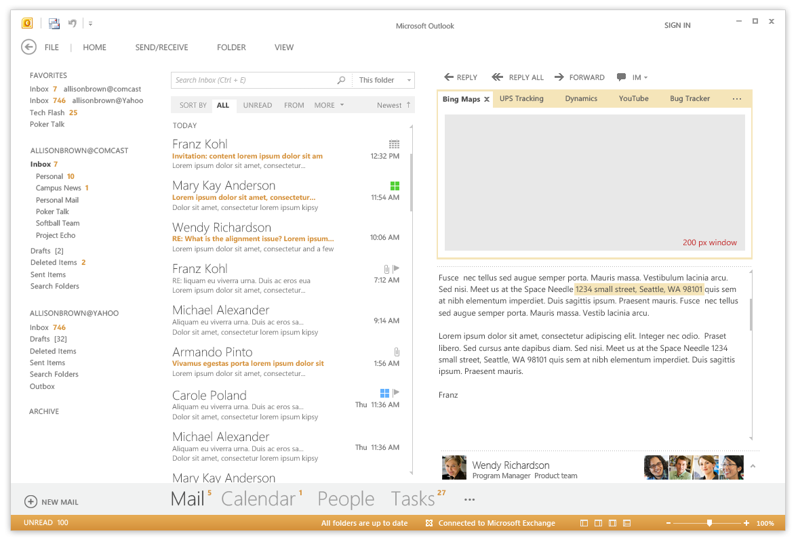
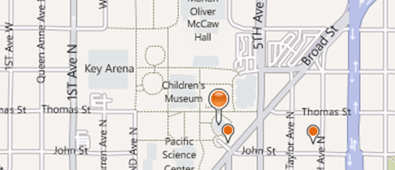
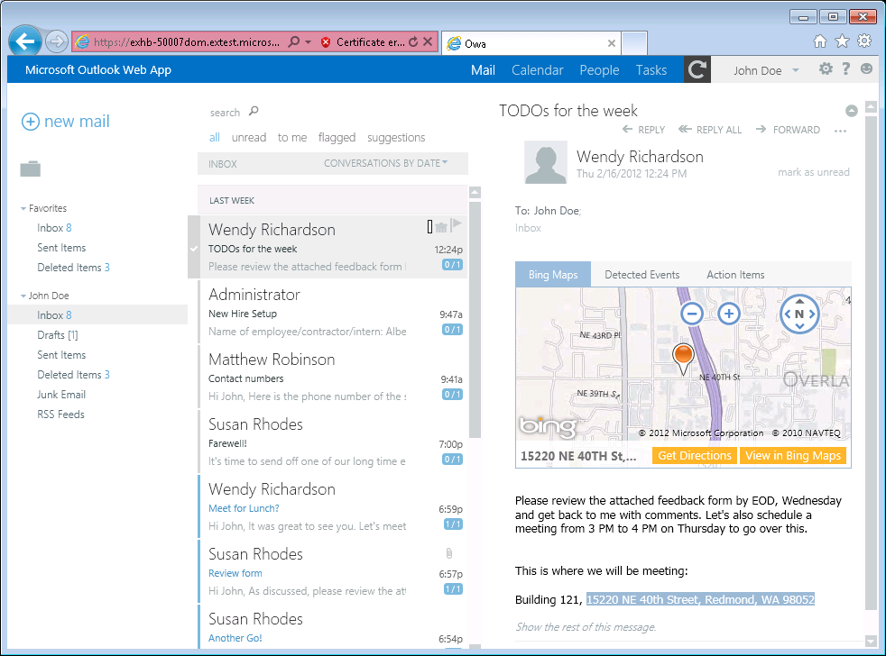
Mail Apps
Write once, run anywhere Outlook runs
Same Mail App runs on Outlook and OWA
Development based on activation rules
Activation rules run whenever user selects item
Activated mail apps are added into Outlook UI
Designed to be secure
Mail apps run in an isolated, sandboxed process
Mails apps run with a three-tier permission model
Notes:
A key concept of mail apps is that they are written once and can run anywhere Outlook runs including the rich client, the browser and mobile devices. The development model for mail apps based on activation rules. The idea is that activation rules for all installed mail apps run whenever user selects item. All mail apps whose activation rules result in activation are then available to use within the context of that selected item. Furthermore, the experience of app activation and starting a mail app is consistent across Outlook and OWA. When a mail app is started by the user, the mail app is designed to provide the user with contextual information for the selected e-mail message, meeting request, or appointment.
The infrastructure for mail apps has been designed to be secure. With Outlook, mail apps are run in an isolated, sandboxed process. In the browser, mail apps are isolated within their own iFrame. As you will see later in this model, mails apps run with a three-tier permission model which affords a great deal of power in a secure manner.

Slide 10

Mail Apps – Up Close and Personal
App Name
Mail App Body
Context trigger
Notes:
This slide shows some key aspects of how mail apps integrate into the Outlook and OWA user interface.
When a mail app has activated for a specific Outlook item, its App Name appears in a special App Bar just above the body of the host mail item. A user can start up a mail app by clicking on the App Name in the App Bar. This action results in the mail app loading which will display the Mail App Body. Many activation rules for mail apps are based on finding specific types of content in the host item. For example, the Bing Maps mail app looks for content inside the body that is interested as an address. Such content is considered a Context Trigger and is highlight in the body of the mail item showing the user what specific data the mail app is using to do its work.

Slide 11
Mail Apps - New Features with SP1
Compose Apps
Office 2013 RTM supported only Read Forms
Office 2013 SP1 supported Compose Forms in addition to Read Forms
Improved access to body and attachment
Accessing attachments no longer requires admin rights
New easy-to-use APIs for accessing attachment name and size

Slide 12
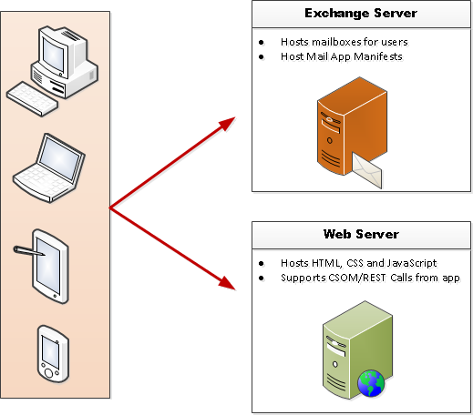
Mail App Hosting
Mail Apps require Exchange 2013
Exchange Server hosts users mailbox
Exchange Server hosts app manifest files
Web server hosts HTML for Mail App
Mail App can make callback to Web server
Mail App can call Exchange Web Services (EWS) EWS calls can be brokered through Web server
EWS
Notes:
The infrastructure for mails apps require Exchange 2013 and an Exchange Server which hosts users mailboxes. When a mail app is installed, its manifest must be uploaded into the Exchange App Catalog. However, the implementation for a mail app which includes HTML, CSS and JavaScript is not deployed with Exchange but instead on any standard Web server that can serve up HTML pages.
One powerful aspect of developing mail apps is that they can call Exchange Web Services (EWS) which provides the ability to create new email message and appointments and to read other mail items in the current users inbox. Calls to EWS can be made directly from JavaScript behind the mail app itself. However, the mail app can also call back to its hosting Web server passing the required security credentials so that the Web server can call into EWS. This makes it possible to work with server-side code behind a mail app that does its work in C# and VBNET and still has the power to call into EWS.

Slide 13
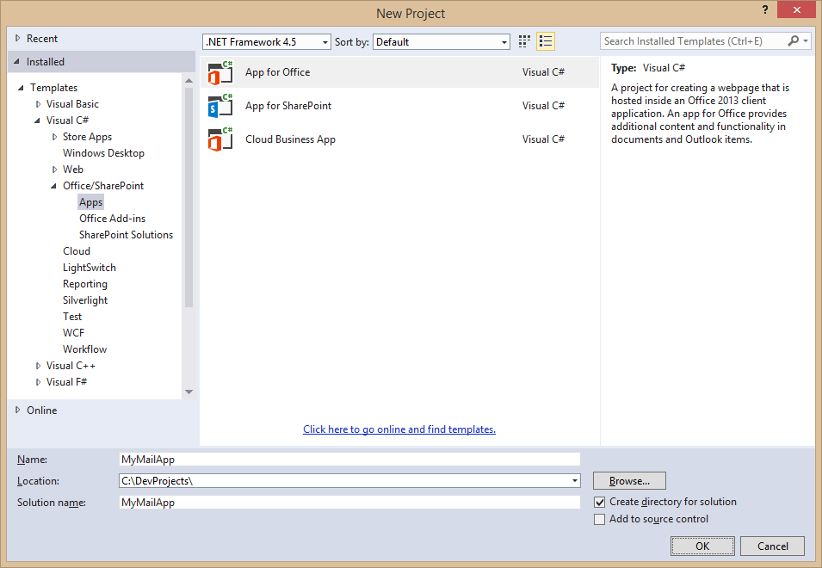
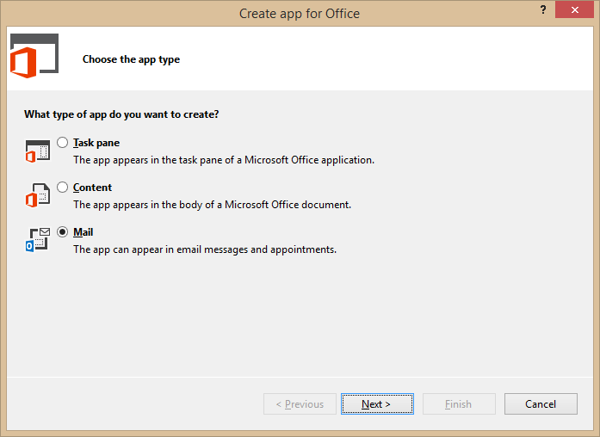
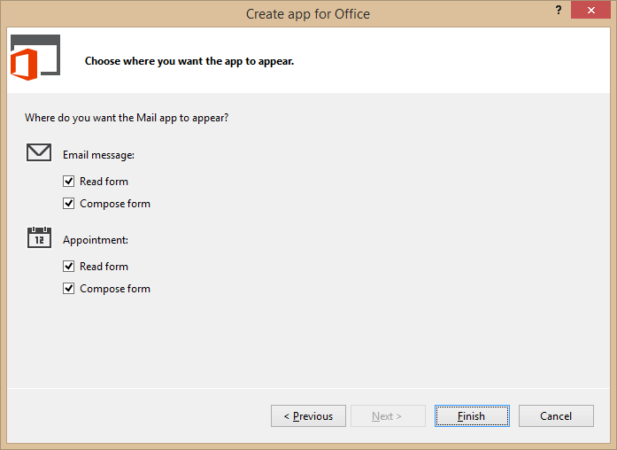
Developing Mail Apps
Use the Visual Studio project template for Mail Apps
Notes:
To create mail app, you can use Visual Studio 2012 and a new project template dedicated to creating mail apps.

Slide 14
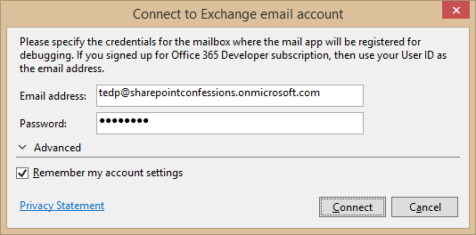
Steps to Implementing, Testing and Debugging
Specify height from 32 to 350 pixels
Define activation rules
Create UI and style with CSS
Write JavaScript to add behavior and business logic
Debug using Exchange Server and a valid Exchange account
Press {F5} and Visual Studio prompts for server and user mailbox credentials
Notes:
This slide details the high-level steps of creating a mail app. Within the app manifest, you should specify a height for the mail app between 32 pixels to 350 pixels. Note that you cannot specify the width as the mail app will take up all the available width in the host application. Next, you define one or more activation rules. Next, you create the user interface for the mail app using HTML5 and CSS. After that, you write JavaScript to add the required behavior and business logic. When you are finally ready to test your work, you can press the {F5} key to begin the debugging process.
In order to test and debug a mail app, you must have a installed version of Exchange 2013 and a valid Exchange account with a mailbox. When you press the {F5} key for the first time Visual Studio 2012 prompts you with the dialog shown above to track the server running Exchange 2013 as well as the login credentials for the user mailbox used for testing.

Slide 15
demo
Creating and Testing a Mail App for Outlook

Slide 16
Contextual Activation and Rules

Slide 17
Rule-based Activation
Mail Apps activate based on rules
Rules are defined in the manifest
Rules are applied to the selected item in the Explorer or Inspector
If conditions are met, the App will be activated and available for use
About rules
Multiple rules can be combined for complex activation needs
Apply logical AND or OR operators
Rules can access known entities such as phone numbers
Rules can be defined using regular expressions
Notes:
Every mail app is created with one or more activation rules. These rules are defined in the app manifest using XML. These activation rules are run for each installed mail app whenever the user select a new mail item that is a mail message, and event or an appointment. If the conditions for an activation rule are met, then the mail app is activated and becomes available to start by the user.
A simple mail app can be based on a single activation rule. However, a mail app can contain multiple rules that can be combined for complex activation needs. When you add more than one activation rule, you must decide whether to AND the rules together or to OR the rules together.
Activation rules can be based on known entities such as address and phone numbers. For more specific scenarios, activation rules can also be defined using custom regular expressions.

Slide 18
Activation Rule Types
ItemIs
A rule that checks the item type (appointment or message)
<Rule xsi:type=“ItemIs” ItemType=“Message”>
ItemHasKnownEntity
A rule to check if the item has a specific type of known entity
<Rule xsi:type=“ItemHasKnownEntity” EntityType=“Address” />
ItemHasRegularExpressionMatch
Defines a rule using a custom regular expression to match the contents of an item
RuleCollection
Defines a rule composed of multiple rules (combined using AND or OR)
Notes:
There are several different types of activation rules.
The ItemIs rule checks to see whether the item type is a message or an appointment.
<Rule xsi:type=“ItemIs” ItemType=“Message”>
The ItemHasKnownEntity rule checks to see if the item has a specific type of known entity
<Rule xsi:type=“ItemHasKnownEntity” EntityType=“Address” />
The ItemHasRegularExpressionMatch rule checks to see if an item has content that matches custom regular expression.
The RuleCollection rule combines two or more inner rules using either the AND operator or the OR operator. When using the AND operator, all inner rules must be met for activation to occur. When using the OR operator, only one inner rule must be met for activation to occur.

Slide 19
Well-known Entity Examples
Outlook is aware of specific types of entities
Items are parsed and scanned for common types of entities
Use ItemHasKnownEntity rules to based activation rules on entities
Within app use API functions getEntities or getEntitiesByType
Entity type | Recognition condition
Address | United States street addresses 1 Microsoft Way, Redmond, WA 07722
EmailAddress | Any SMTP email address
MeetingSuggestion | A reference to an event or meeting Let’s meet next Tuesday for lunch.
Contact | A personal name related to other entities Steve Ballmer, Microsoft, 1 Microsoft Way, Redmond, WA 07722
PhoneNumber | United States telephone numbers (507) 555-1212
TaskSuggestion | Actionable sentences in an email Please install Office 2013 on my computer.
Url | A file name or web address
Notes:
Outlook 2013 is aware of several specific well-known types of entities which are listed in the table on the slide above. When you create an activation rule based on one of these entities, Outlook will parse and scan the current item for the presence of content that matches that type of entity.
To create an activation rule based on a well-known entity with XML inside the app manifest, you use the ItemHasKnownEntity rule
<Rule xsi:type=“ItemHasKnownEntity” EntityType=“Address” />
When you are writing JavaScript code for the mail app, you will need to retrieve the entity value which can be done using the API functions getEntities or getEntitiesByType.

Slide 20
demo
Creating Rules that Trigger Activation

Slide 21
Using JSOM for Outlook

Slide 22
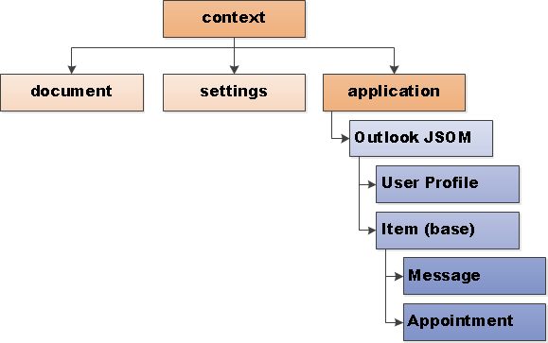
Accessing the Outlook JSOM
Outlook App OM available application object
Notes:
Access to the Outlook JavaScript Object Model (JSOM) is available through the Office.context.application object. From here you can obtain access to information about the selected mail item and user profiles for the current user as well as other users such as the one that sent the message.

Slide 23
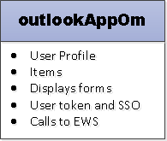
The Outlook App OM for Mail Apps
Access to item properties
Recipients of the current message
Subject, date sent and other item properties
Meetings (start, end, attendees and location)
User profile info
Name, email address, time zone
Regex matches and known entities
Use for activation rules and within App
Limited Exchange Web Services (EWS) access
Look up items in mailbox
Create appointments, messages, tasks and contacts
Send messages/meeting invites
Token for Single Sign-on
Notes:
The Outlook JSOM provides access to item properties such as the sender and the recipients of the current message. There are also properties providing access the item information such the subject and the date sent.
For meeting and appointment items, you can access the date and time of the stat and end as well as all attendees and meeting location.
User profile information available includes the name, email address and time zone.
You can access matches to well-known entities and regular expression matches.
If your mail app has requested the appropriate level of permissions, the code in your mail app also has limited access to Exchange Web Services (EWS). This makes it possible to enumerate through and look up other items in the current user's mailbox. You can also create appointments, messages, tasks and contacts as well as create and send messages and meeting invites.
The JSOM also provides a means to create a single sign-on token that is used to call into EWS.

Slide 24




Outlook APIs – some examples
Accessing item properties:
Accessing user profile info:
Access to regex matches:
Access to extracted entities:
Notes:
The slide above shows some code examples to get you started with the JSOM.
The item provides access to item properties such as subject.
The userProfile property provides access to properties such as displayName.
The getRegExMatches method provides access to content found which matches a regular expression that has been included in an activation rule.
The getEntities method provides access to content found which matches a well-known entity that has been included in an activation rule

Slide 25
Advanced Outlook App OM Functions
OutlookAppOM has several useful methods
displayAppointmentForm – Displays existing appointment
displayMessageForm – Displays existing email message
displayNewAppointmentForm – Displays new appointment form
getUserIdentityTokenAsync – Gets identity token of the user
makeEwsRequestAsync – Call Exchange Web Services service
Notes:
The OutlookAppOM object provide several useful methods for more advanced scenarios.
The displayAppointmentForm method is used to display a standard form showing information for existing appointment
The displayMessageForm method is used to display an existing email message
The displayNewAppointmentForm method is used to display a new appointment form for cases where the user needs to fill in information to create a new appointment.
The getUserIdentityTokenAsync is used to retrieve a security token which can be used to make multiple calls back to EWS under the identity of the current user.
The makeEwsRequestAsync method is used to call a function exposed by EWS.

Slide 26
Using Custom Properties
Custom properties are associated with an item
Similar to settings for a document-centric Apps for Office
Difference is data is associated with item instead of document
When items re-opened, app can load/process/display property
Using custom properties
Item object has loadCustomPropertiesAsync method
CustomProperties object has methods for get, set, remove and saveAsync
Notes:
The JSOM object model makes it possible to save one or more custom properties for a mail item and to later retrieve them to implement custom business logic. Remember that each custom property value is associated with exactly one item. Programming custom properties in a mail app is similar to the way it works in a document-based app. The main difference is that property values are associated with items instead of documents. When an mail app is started within a scope of an item, you can write code to load the custom properties to retrieve custom property values that have been save at an earlier time.
When you need to actually write the code to work with custom properties, you will use the loadCustomPropertiesAsync method available on the item object. Once you create a custom property, you must save your work by calling the saveAsync method.

Slide 27
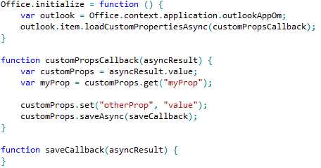
Outlook APIs for Custom Properties
Custom Properties are per-app, per-item property bag
Saved on the Exchange server
Uses async programming pattern
Notes:
Custom properties are stored in Exchange server on a per-app basis which implies that two different mail apps can read and write a common set of custom properties. The code in the slide above shows a simple example demonstrating how to read and write custom properties. You start by calling loadCustomPropertiesAsync and passing a callback method. This callback method is passed a asyncResult object with a value property which contains the collection of existing custom properties. You can read an existing property value by calling the get method and passing the property name. The get method returns an undefined value if the named property does not already exist.
You can use the save method to create a new property or to update the value of an existing property. Note that the save method has no real effect unless you follow it with a call to saveAsync to save the new property value back to the Exchange server.

Slide 28
demo
Programming an App for Outlook Using Javascript

Slide 29
Compose Apps

Slide 30
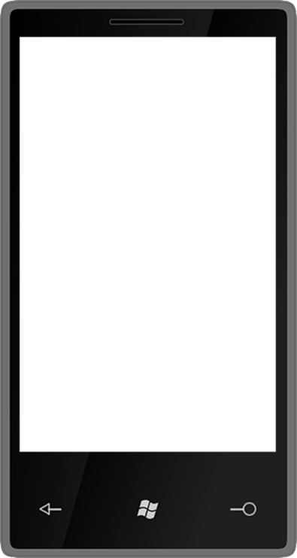

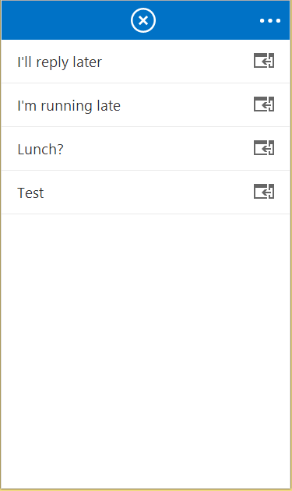
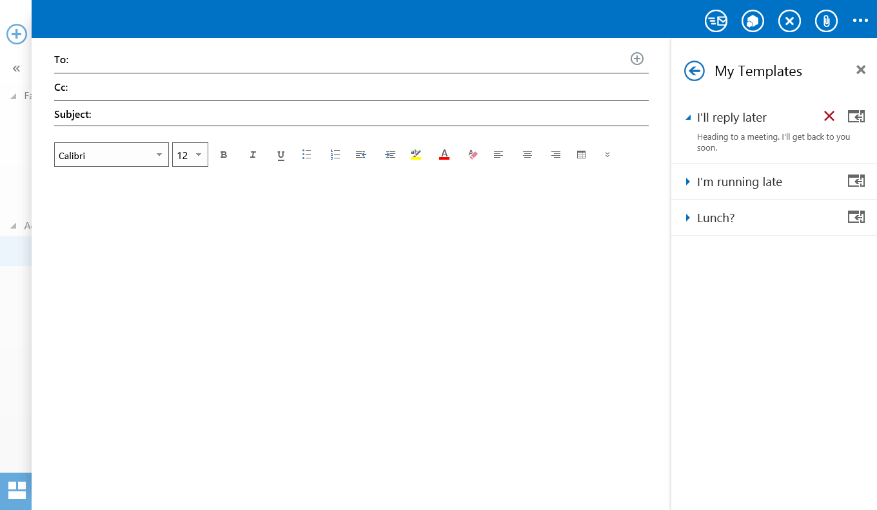
Compose App Activation
Apps can appear in messages and/or appointments
Compose apps are across Desktop, Tablet and Mobile

Slide 31
Compose mail app capabilities
Use core JS APIs
Read/Write recipients
Read/Write subject
Add attachments
Write to the body
R/W appointment properties
Custom item properties
User Identity Token
Make EWS requests
Settings
User Profile

Slide 32
Compose mail app capabilities
Use core JS APIs
Read/Write recipients
Read/Write subject
Add attachments
Write to the body
R/W appointment properties
Custom item properties
Get/set/add recipients or
attendees
Get/set the subject

Slide 33
Compose mail app capabilities
Use core JS APIs
Read/Write recipients
Read/Write subject
Add attachments
Write to the body
R/W appointment properties
Custom item properties
Add file or item attachments

Slide 34
Compose mail app capabilities
Use core JS APIs
Read/Write recipients
Read/Write subject
Add attachments
Write to the body
R/W appointment properties
Custom item properties
Prepend to the body
Overwrite current selection in body

Slide 35
Compose mail app capabilities
Use core JS APIs
Read/Write recipients
Read/Write subject
Add attachments
Write to the body
R/W appointment properties
Custom item properties
Get/set start or end time
Get/set location
Get/set/add attendees

Slide 36
Compose mail app capabilities
Use core JS APIs
Read/Write recipients
Read/Write subject
Add attachments
Write to the body
R/W appointment properties
Custom item properties
Saved on the sent item
Can be used to mark a composed message (eg “Tracked” in CRM)

Slide 37
Security Considerations

Slide 38
Four Stakeholders of Security
Office Marketplace hosted by Microsoft
Ensure integrity of marketplace
Perception of Microsoft products
App Developers
Needs to be aware of security-related constraint
Ability versus constraint
End Users
Privacy of personal information
Protect computers from attack
IT Department & Exchange Administrator
Privacy and protection of corporate information
Protect computers from attack
Notes:
There are four main stakeholders in the security story for mail apps.
The Office.com team at Microsoft hosts The Office Marketplace and has the incentive to ensure the integrity of all mail apps available in the Marketplace.
Mail app developers need to be aware of security-related constraints. It is essential to understand the trade off between requesting higher levels of permission to provide the mail app with greater ability and working under constraints enforced by lower permission levels as to not require higher levels of trust from users and administrators. The bottom line is that your mail app should request the minimum of permissions that are required.
End users are concerned with the privacy of their personal information and with the ability to protect their computers and mobile devices from attack
The IT Departments and Exchange Administrators are concerned with the privacy and protection of corporate information and intellectual properties. They are also concerned with protecting all computers including servers from attack.

Slide 39
Permissions
ReadWriteMailbox
ReadItem
Restricted
ReadWriteItem
Restricted
App can access data from limited entities
Regular expressions are blocked
JS API limits item data access
ReadItem
App can access data from all entities
Regular expressions allowed
Read JS APIs are allowed
EWS calls are not allowed
ReadWriteItem
All JS APIs are allowed
ReadWriteMailbox
Limited EWS methods are allowed
Admins can install
End-users can install

Slide 40

© 2012 Microsoft Corporation. All rights reserved. Microsoft, Windows, and other product names are or may be registered trademarks and/or trademarks in the U.S. and/or other countries.
The information herein is for informational purposes only and represents the current view of Microsoft Corporation as of the date of this presentation. Because Microsoft must respond to changing market conditions, it should not be interpreted to be a commitment on the part of Microsoft, and Microsoft cannot guarantee the accuracy of any information provided after the date of this presentation. MICROSOFT MAKES NO WARRANTIES, EXPRESS, IMPLIED OR STATUTORY, AS TO THE INFORMATION IN THIS PRESENTATION.

